Slide 1
TrackerBot:
Object Tracking and Collision Avoidance using UGV
Faculty Guide: Dr. Pushan Kumar Dutta
Authors: Madhushree Sannigrahi (A910119819007), Abhimanyu Bhowmik (A910119819008), Yanamareddy Pravallika (A910119819016) and Prithwish Guha (A910119819011)

Slide 2
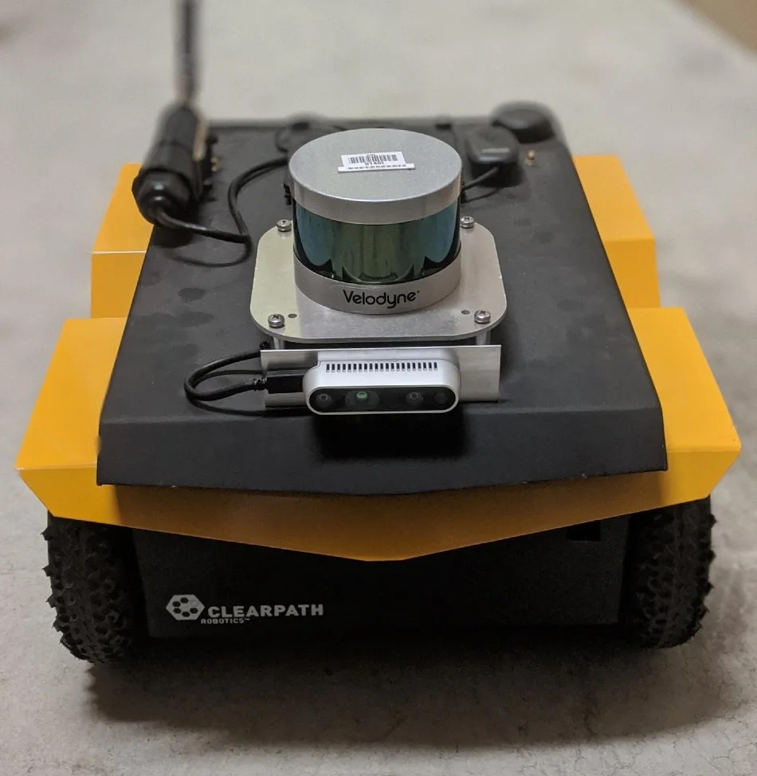
Abstract
Autonomous rovers: robots with sensors, actuators, and control systems for independent operation.
Goal: Create a system for safe navigation and capturing high-quality visual data of moving objects.
Control system: Combines classical controllers (PID) with computer vision techniques.
Features: Simultaneous object detection and tracking, obstacle avoidance, and minimal hardware requirements for video recording.

Slide 3
Introduction
Autonomous rovers are mobile robots, designed to operate in various conditions without any human intervention.
These rovers are equipped with sensors, actuators, and control systems that enable them to navigate and interact with their environment.
They are widely employed in fields like exploration, search and rescue, environmental monitoring, and surveillance.

Slide 4
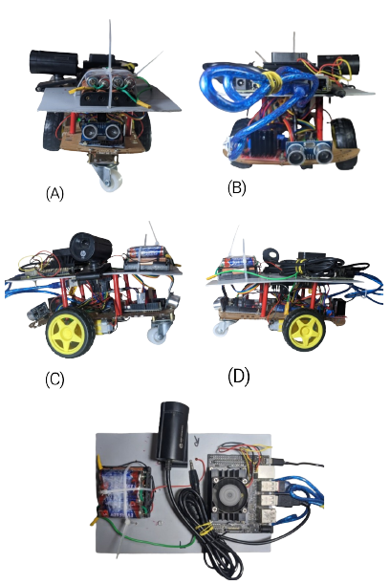
Key Contributions
A novel framework for combining videography, computer vision, navigation, and tracking is proposed in this research.
One-of-its-kind tracking system, using minimal sensors.
The implemented algorithm parameters have all been fine-tuned specifically for this hardware component.
The rover’s custom hardware was made up of both pre-built and recycled and re-purposed parts.

Slide 5
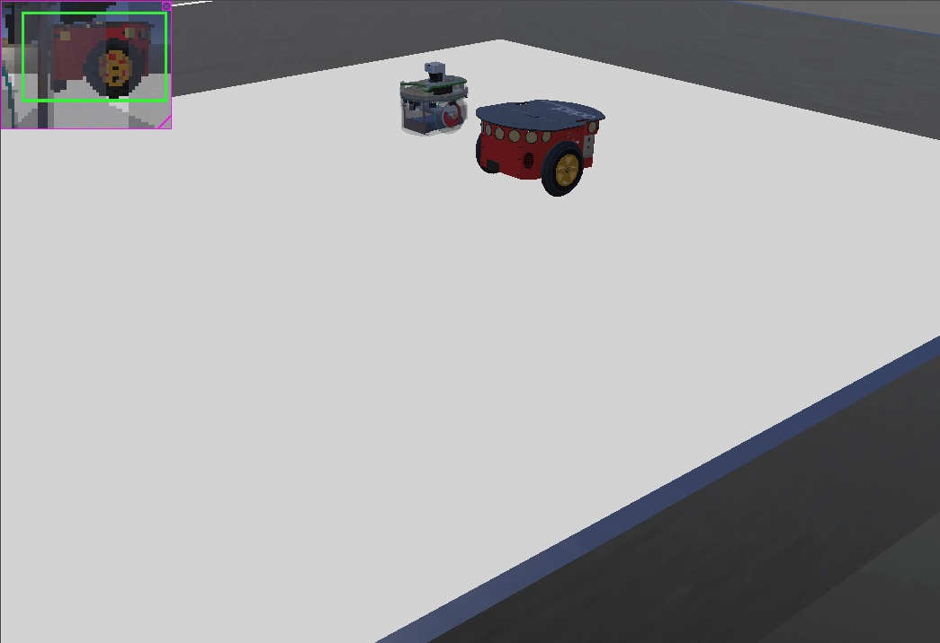
Simulation
Simulation played a huge role in the development of the AGV.
The entire setup was initially implemented in a simulated environment using “WeBots"
For this, "Epuck" was taken as the subject robot and "Pioneer" as the tracking matter.
The PID controller and Kalman filter were also first calibrated and stabilised in the virtual setting.

Slide 6

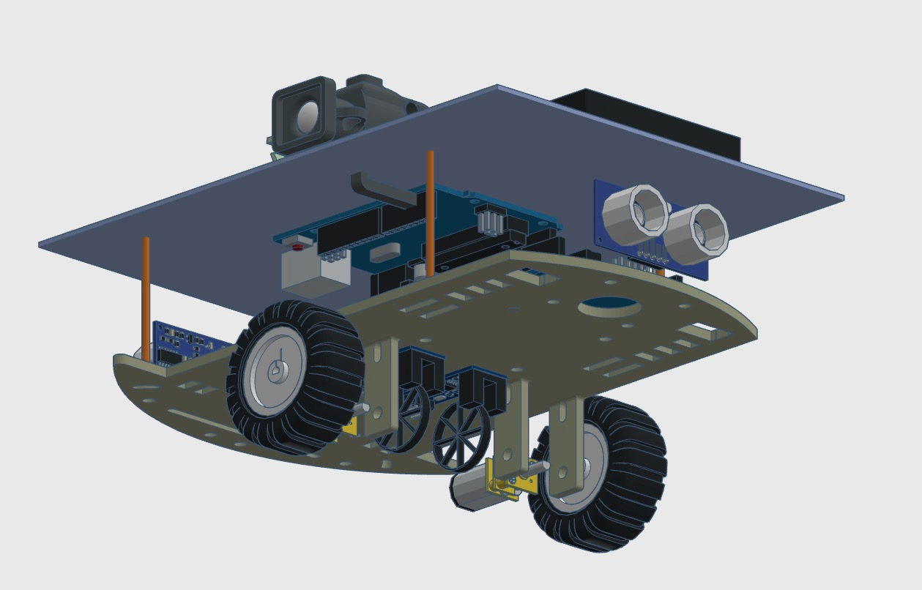
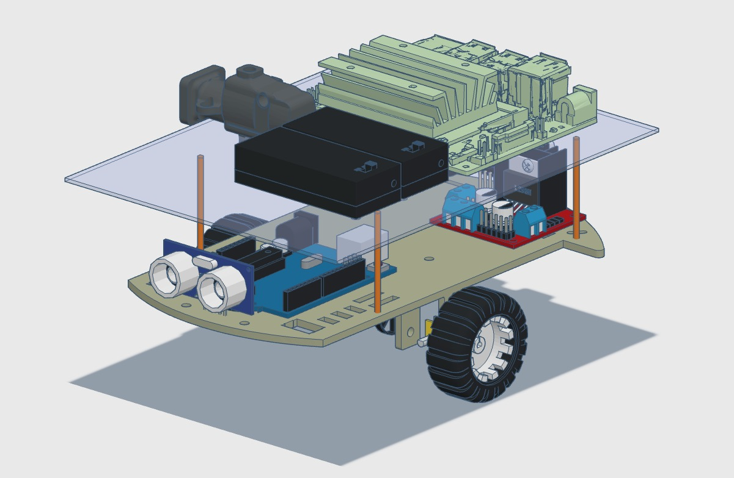
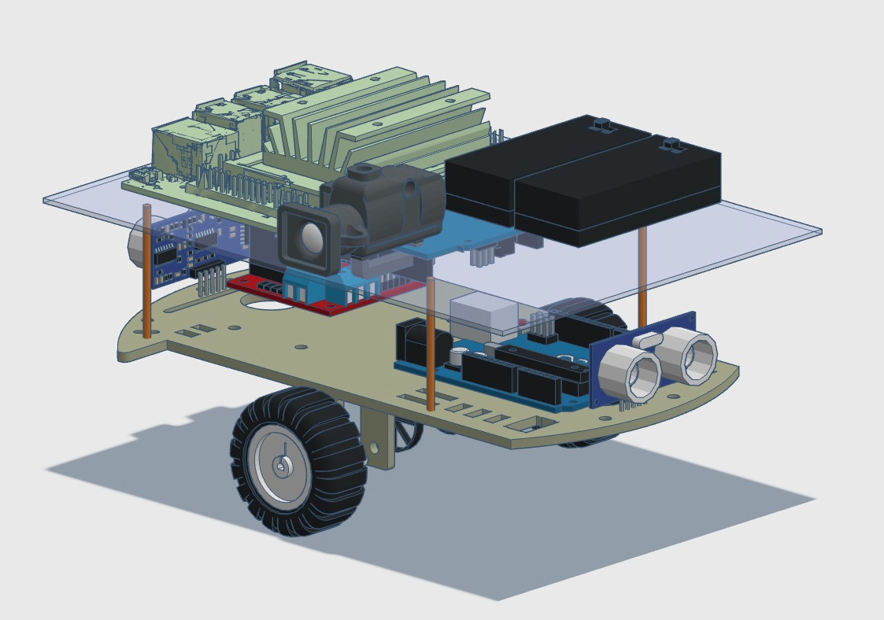
Prototyping

Slide 7
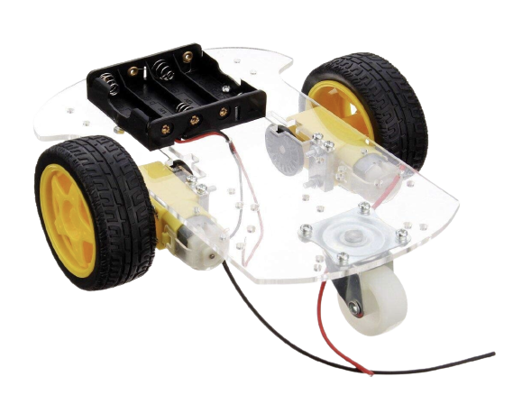
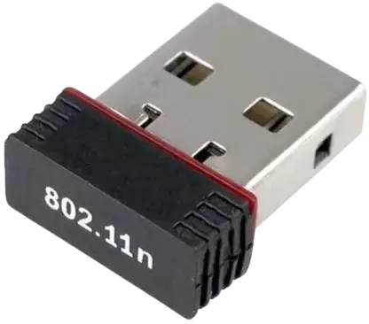
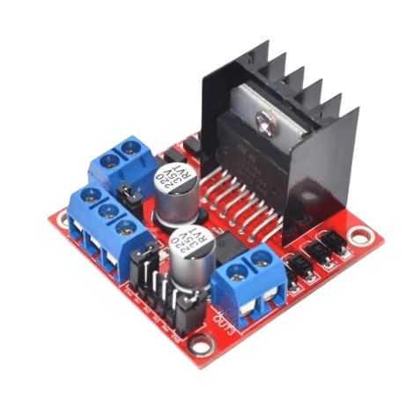
Mechanical Subsystem
Wifi Adapter
Single-storey Chassis
L298 Driver

Slide 8
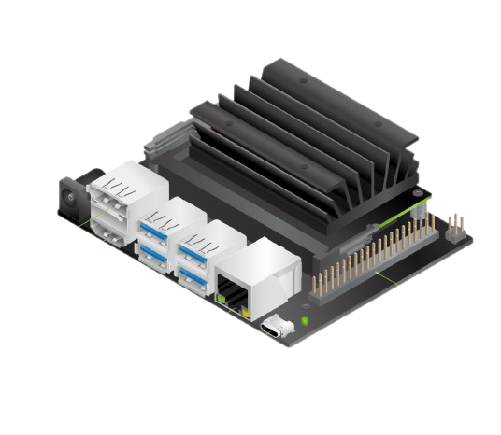
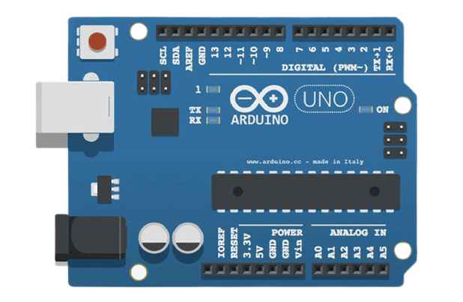
Micro-controllers and GPU
Arduino UNO as micro-controller
Jetson Nano as main computer/GPU of the AGV

Slide 9
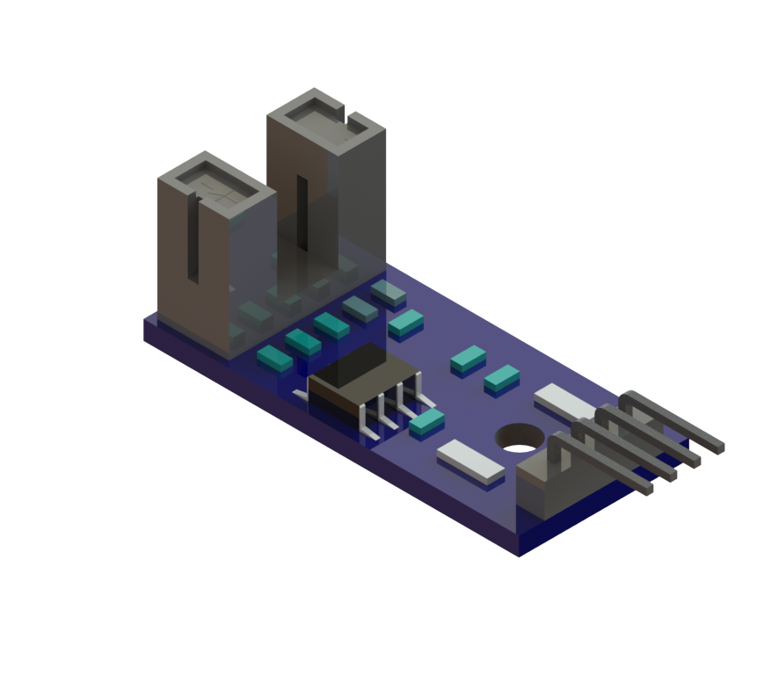
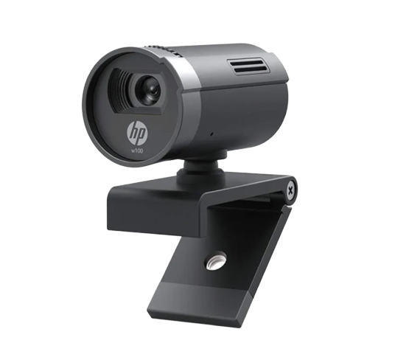
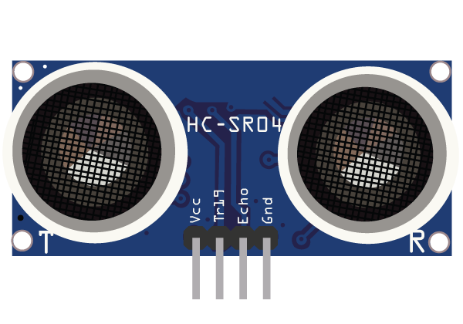
Sensors
HP w100 480P 30 FPS Digital Webcam
Ultrasonic Sensors
LM393 Speed Sensor

Slide 10
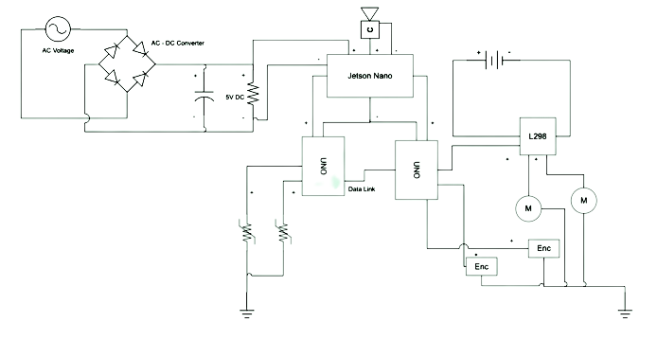
The Overall Power System

Slide 11
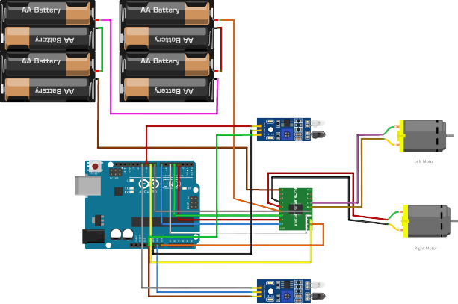
Basic
Navigation System

Slide 12
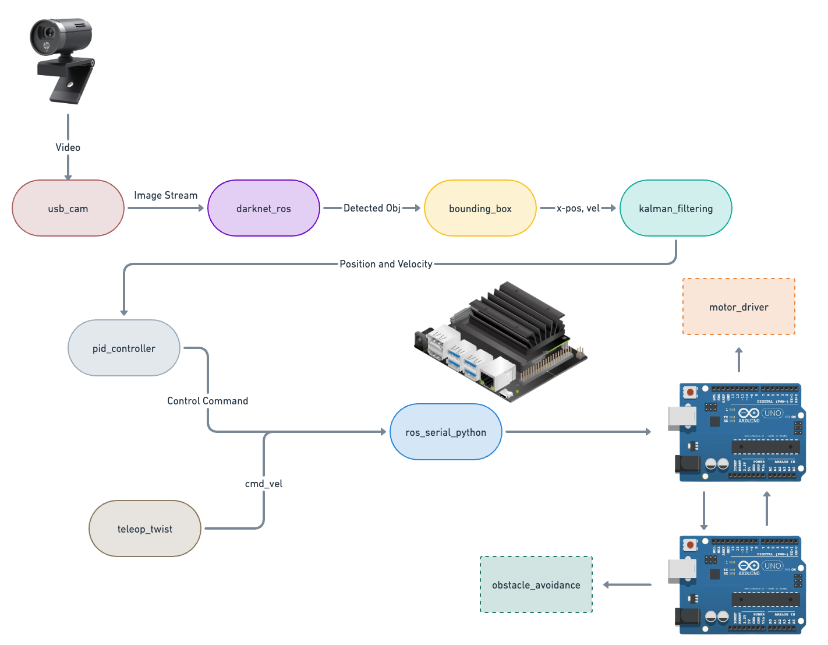
Vision and Tracking
The ROS architecture

Slide 13
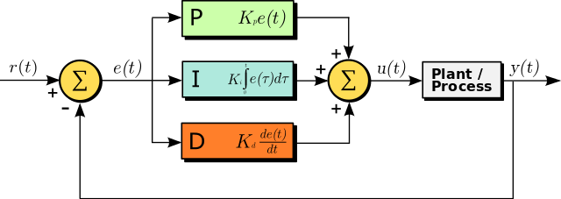
PID Controller
PID controller: Proportional-Integral-Derivative controller
Proportional term responds to current error, integral term corrects accumulated error, derivative term predicts future error changes.
Balances stability and responsiveness in control systems.

Slide 14
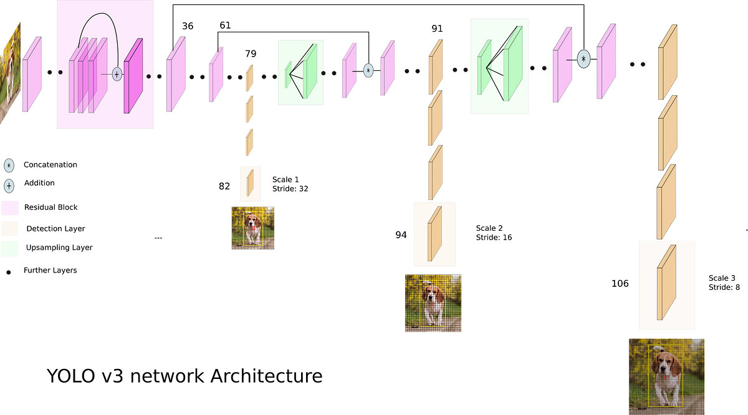
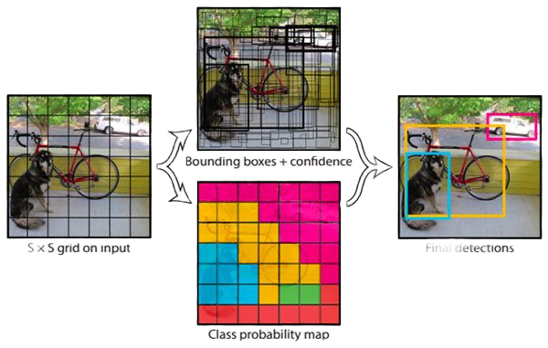
YOLO v3
YOLO v3: You Only Look Once version 3.
Divides image into grid cells and predicts bounding boxes and class probabilities.
Simultaneously detects multiple objects in a single pass.

Slide 15
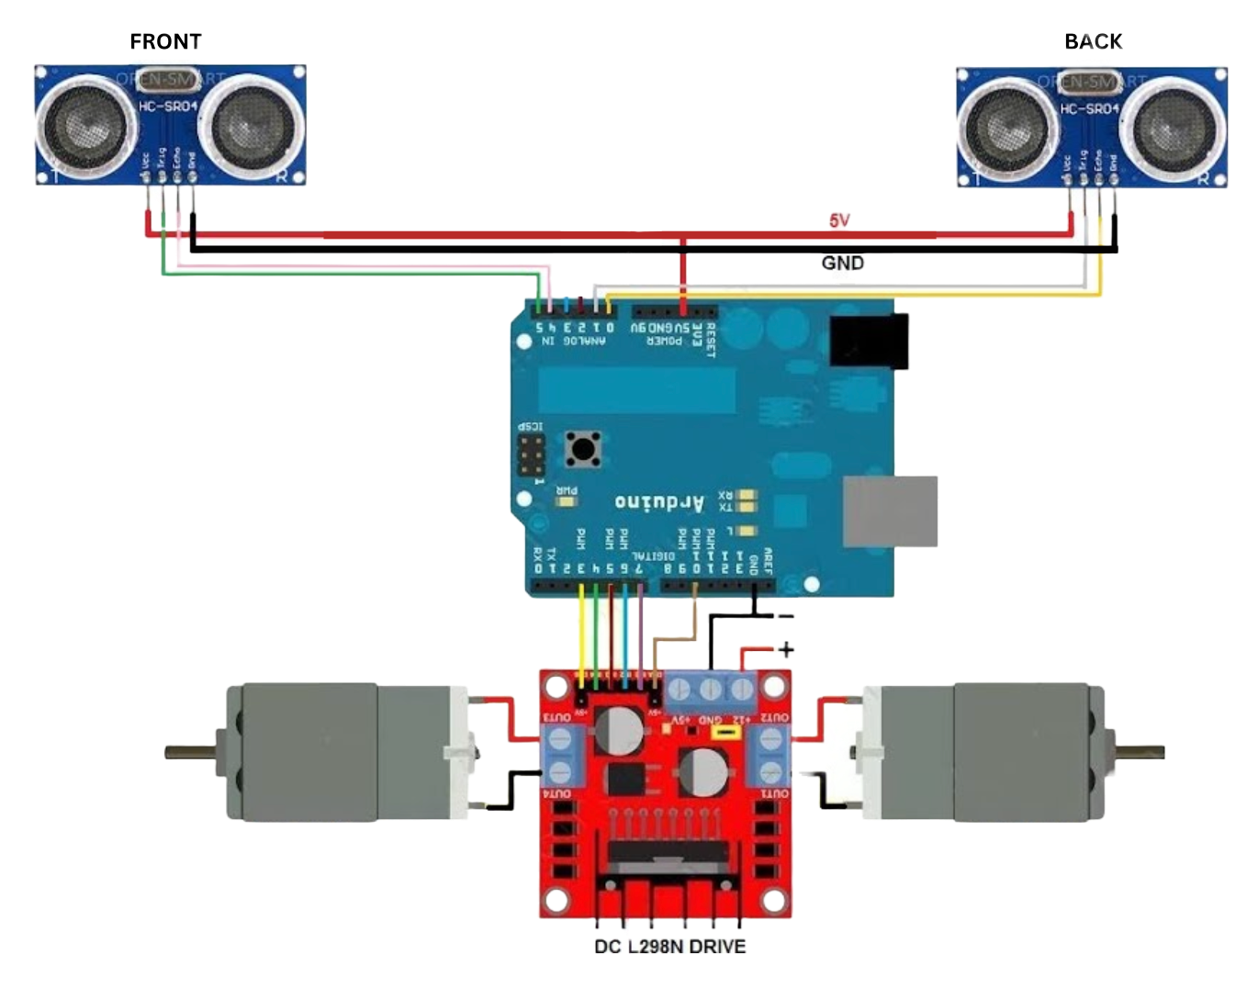
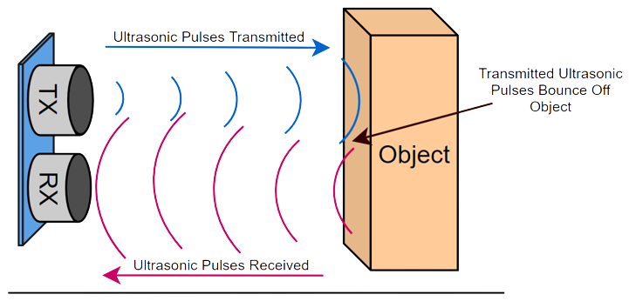
Obstacle
Detection System

Slide 16
Results and Discussions

Slide 17
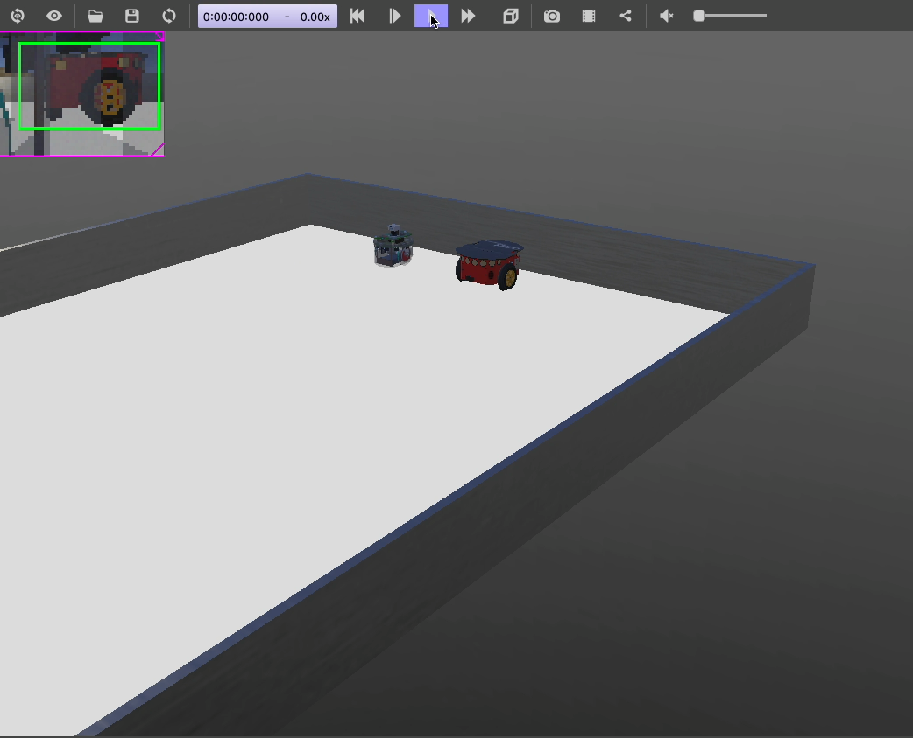
WeBoT
Simulation

Slide 18
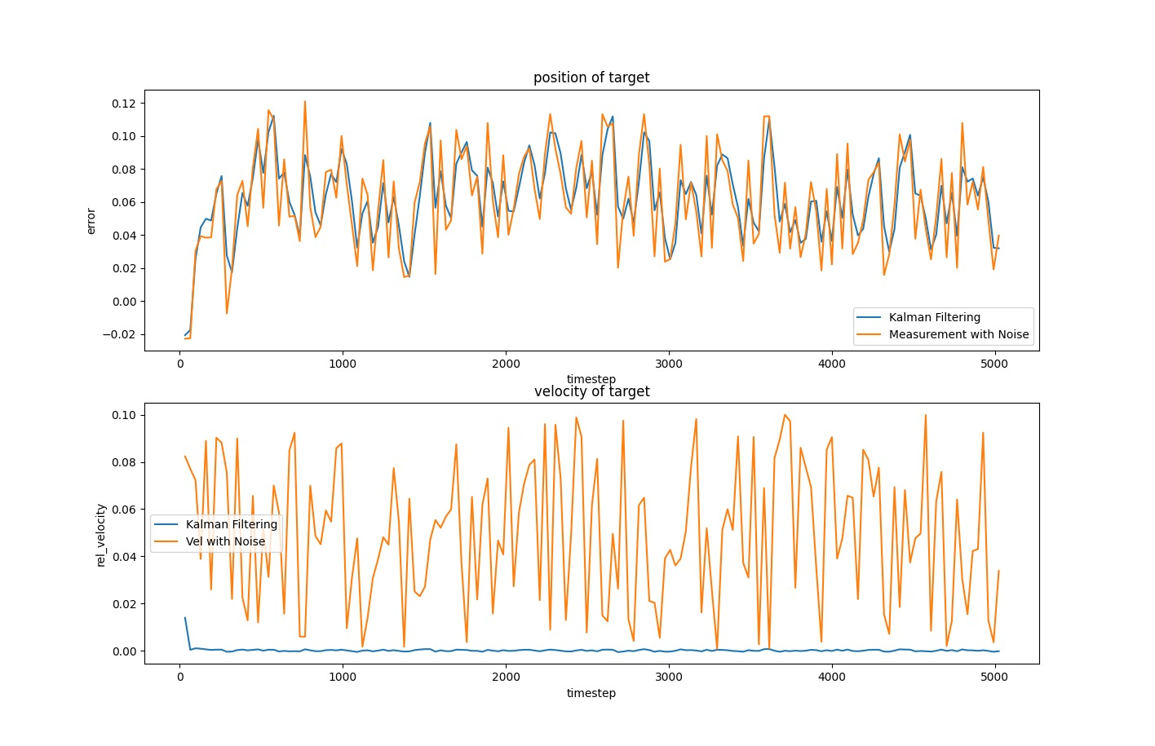
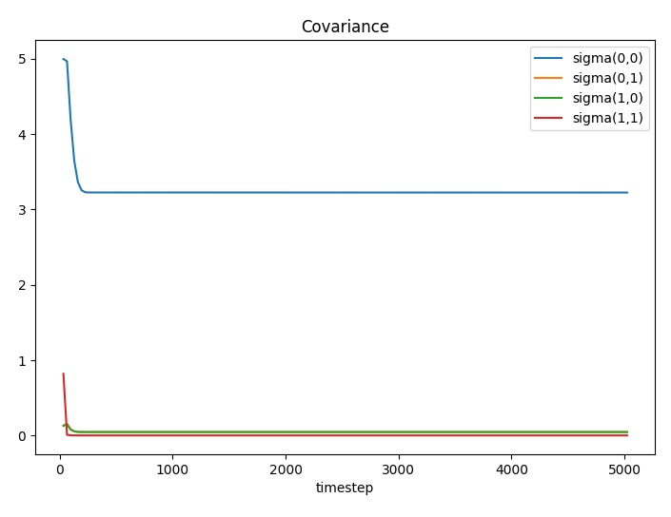
Kalman Filter Comparison Graphs
Position-velocity graph as a result of Kalman Filter
Covariance-timestep plotting

Slide 19
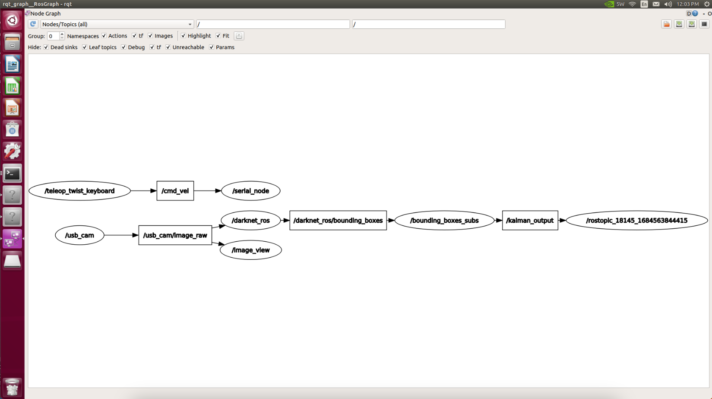
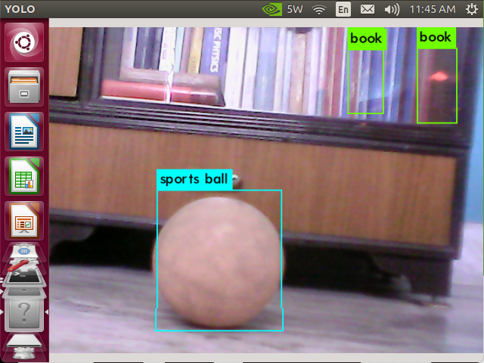
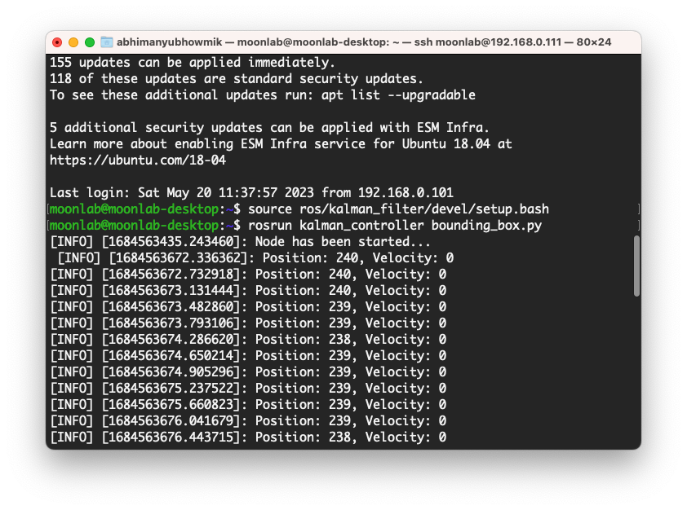
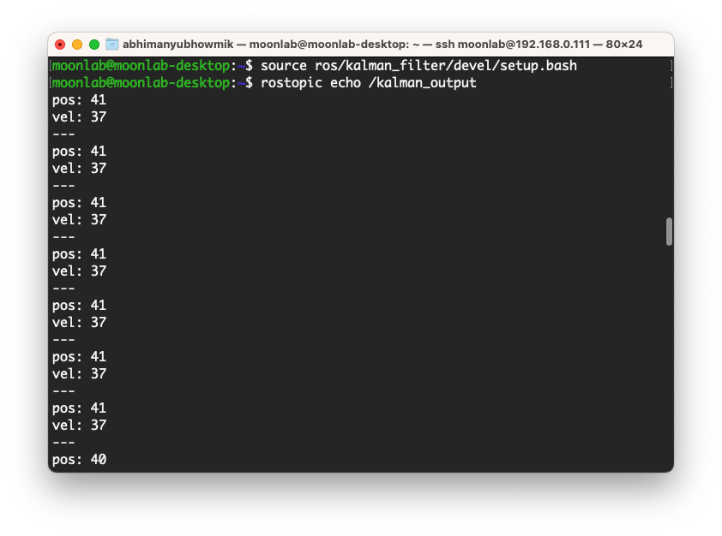
rqt_graph
YOLO is running on the darknet-ros node
KalmanFilter Node which has been subscribed to bounding boxes publish refined output of X - position and velocity w.r.t. centre point of the camera
Bounding box node publishing X axis position and velocity

Slide 20


Slide 21
Conclusion and Future Works
While the project has reached important milestones, there are still a number of opportunities for new research and advancements in the area of mobile autonomous robots.
Enhanced Perception: Better high-resolution sensors, high processing algorithms
Safety and Ethical Issues: Addressing human-robot safety and ethical issues
Real-World Scalability: Building a multi-robot system
Intelligent Decision-Making: More sphisticated AI methods like reinforcement learning
Long-Term Autonomy: Creating energy-efficient tactics like adaptive power management or self-recharging capabilities

Slide 22
References
R. Schiavi, A. Bicchi, and F. Flacco, “Integration of active and passive compliance control for safe human-robot coexistence,” in 2009 IEEE International Conference on Robotics and Automation, pp. 259–264, IEEE, 2009.
A. De Luca and F. Flacco, “Integrated control for phri: Collision avoidance, detection, reaction and collaboration,” in 2012 4th IEEE RAS & EMBS International Conference on Biomedical Robotics and Biomechatronics (BioRob), pp. 288–295, IEEE, 2012.
G. Antonelli, S. Chiaverini, and G. Fusco, “A new on-line algorithm for inverse kinematics of robot manipulators ensuring path tracking capability under joint limits,”IEEE Transactions on Robotics and Automation, vol. 19, no. 1, pp. 162–167, 2003.
J. Kr ̈uger, B. Nickolay, P. Heyer, and G. Seliger, “Image based 3d surveillance for flexible man-robot-cooperation,” CIRP annals, vol. 54, no. 1, pp. 19–22, 2005.
K. Harada, S. Kajita, F. Kanehiro, K. Fujiwara, K. Kaneko, K. Yokoi, and H. Hirukawa, “Real-time planning of humanoid robot’s gait for force-controlled manipulation,” IEEE/ASME Transactions on Mechatronics, vol. 12, no. 1, pp. 53–62, 2007.
J. Minguez and L. Montano, “Extending collision avoidance methods to consider the vehicle shape, kinematics, and dynamics of a mobile robot,” IEEE Transactions on Robotics, vol. 25, no. 2, pp. 367–381, 2009.

